Slide 1

WAY TO ENTERPRISE
React JS
VTI ACADEMY
Author: duy.nguyenngoc1@vti.com.vn
March 2020

Slide 2
Agenda
Fragment
Form
Event
List
Render Element
Assignments
Copyright © VTI Academy All Rights Reserved

Slide 3
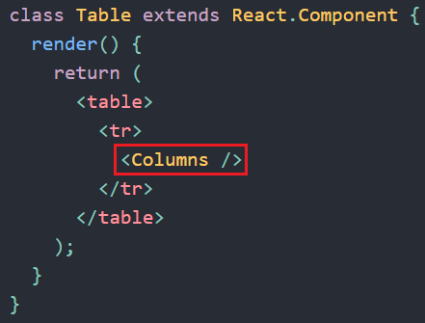
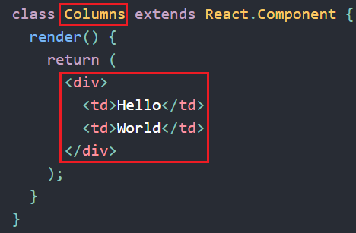
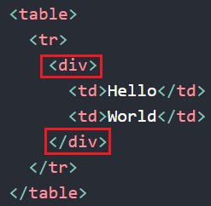
Fragment
Problem when using div for grouping element as rendering
Using div for grouping element

Slide 4
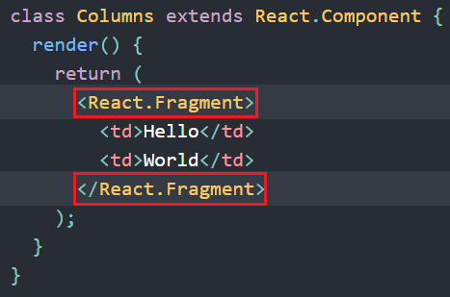
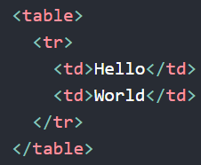
Fragment
Instead of Fragment
Using Fragment for grouping element

Slide 5
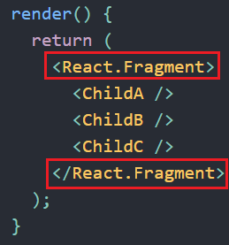
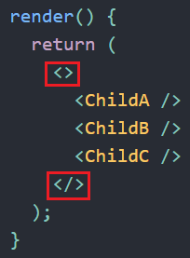
Fragment
Syntax
Shortcut

Slide 6
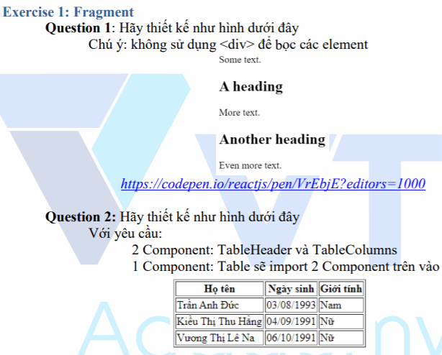
Testing System Assignment
Exercise 1: Fragment

Slide 7
Form
Works slightly differently from other DOM element
Content
Single source of truth
Controlled Component
Uncontrolled Component

Slide 8
Single source of truth
There is only one object responsible for holding and updating the value
Example: In Javascript
The Browsers keeps the value of input ➔ single source of truth
If we store a variable in Javascript that refers to value it will be two sources of truth

Slide 9
Controlled Component
The data in the form is managed by React in the form of state or store ➔ single source of truth
Most forms are Controlled Component
Re-render a lot

Slide 10
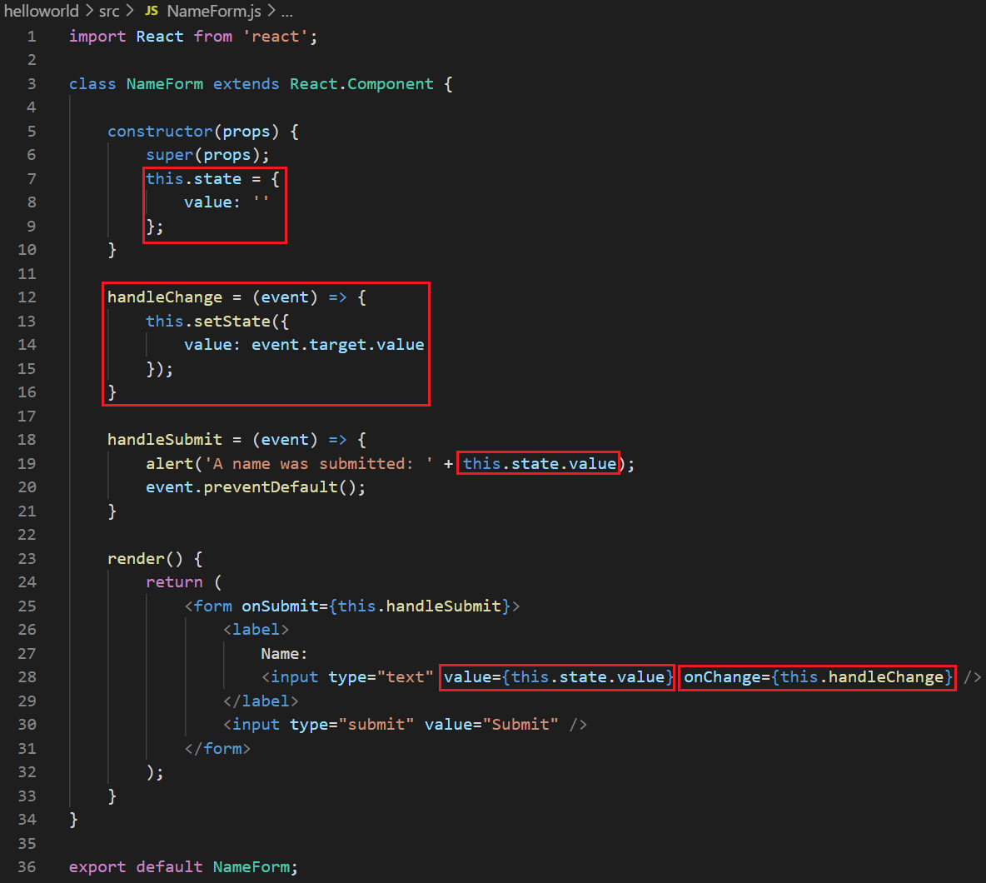
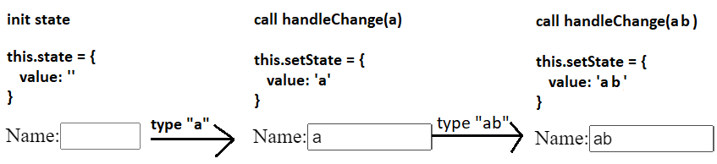
Controlled Component
Example1: <input> tag
Input text🡪 setState()🡪 re-render
https://codepen.io/gaearon/pen/VmmPgp?editors=0010
Data is managed by React

Slide 11
Testing System Assignment
Self-practice

Slide 12
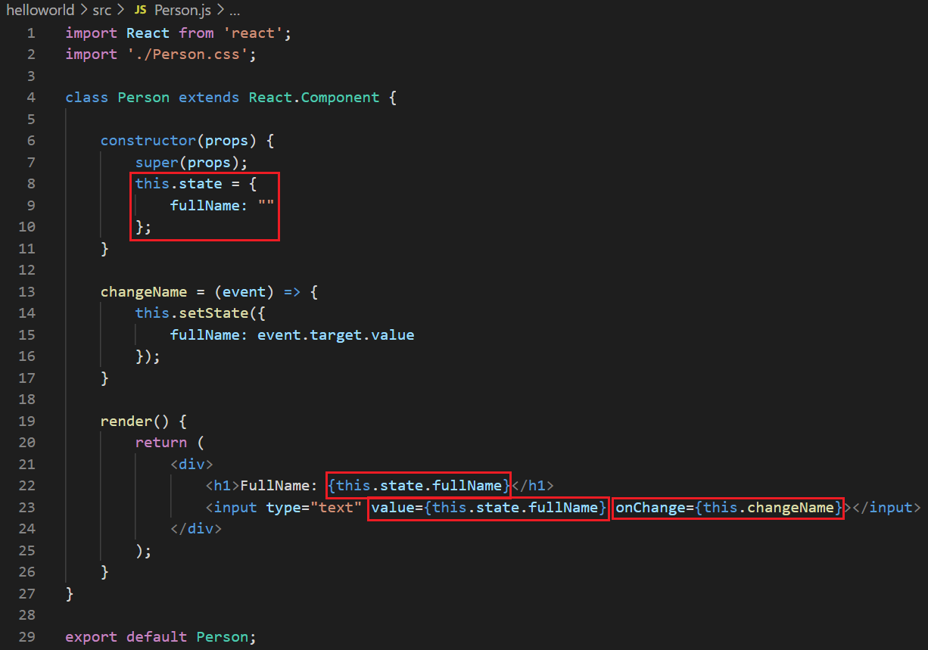
Controlled Component
Example 2: Two way binding

Slide 13
Testing System Assignment
Self-practice

Slide 14
Controlled Component
Example: <textarea> tag
https://reactjs.org/docs/forms.html#the-textarea-tag
Example: <select> tag
https://codepen.io/gaearon/pen/JbbEzX?editors=0010
Example: validate form
https://goshakkk.name/on-forms-react/

Slide 15
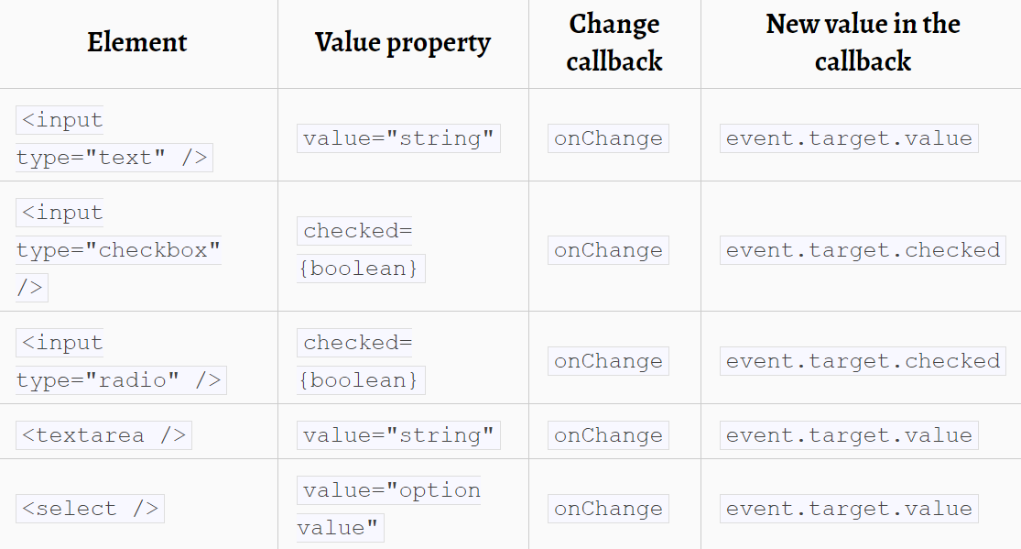
Controlled Component
Attribute

Slide 16
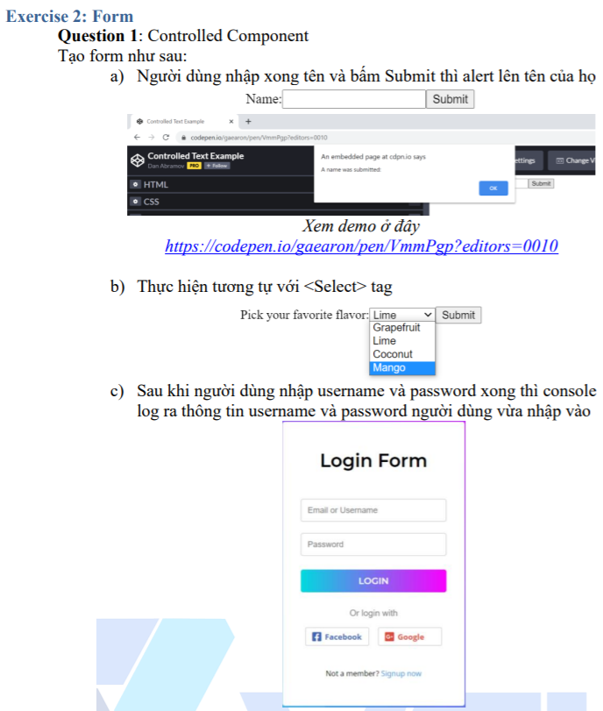
Testing System Assignment
Exercise 2: Form

Slide 17
Uncontrolled Component
The data in the form is directly managed by DOM (similar to traditional HTML) ➔ single source of truth
Using for Integrating Non-React code
Not much re-rendering

Slide 18
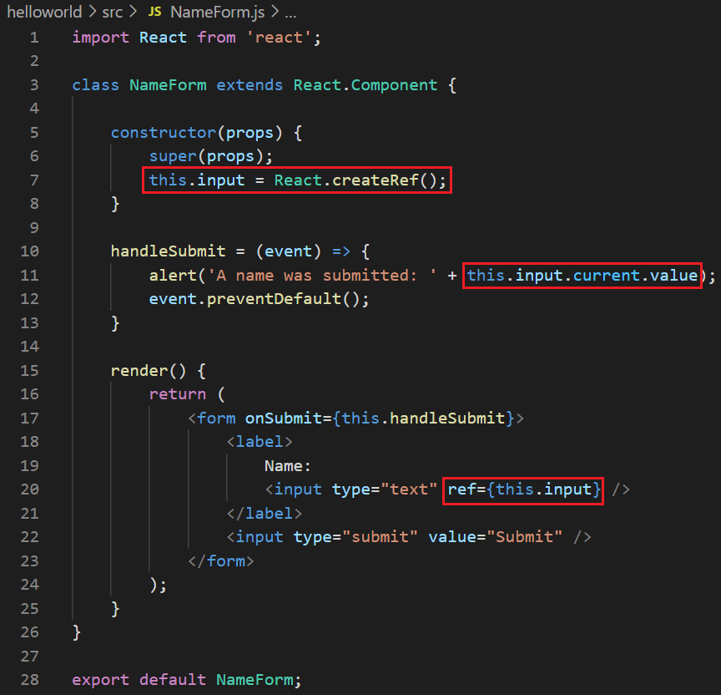
Uncontrolled Component
Example 1:
https://codepen.io/gaearon/pen/WooRWa?editors=0010
Using ref to access input’s value from DOM (instead of getElementByID in traditional HTML

Slide 19
Testing System Assignment
Self-practice

Slide 20
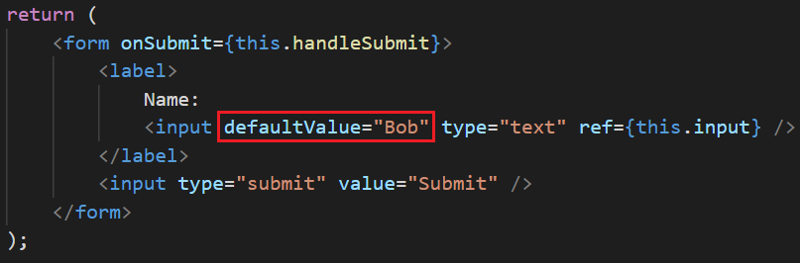
Uncontrolled Component
Example 2: Default value
Change value to defaultValue
Change checked to defaultChecked

Slide 21
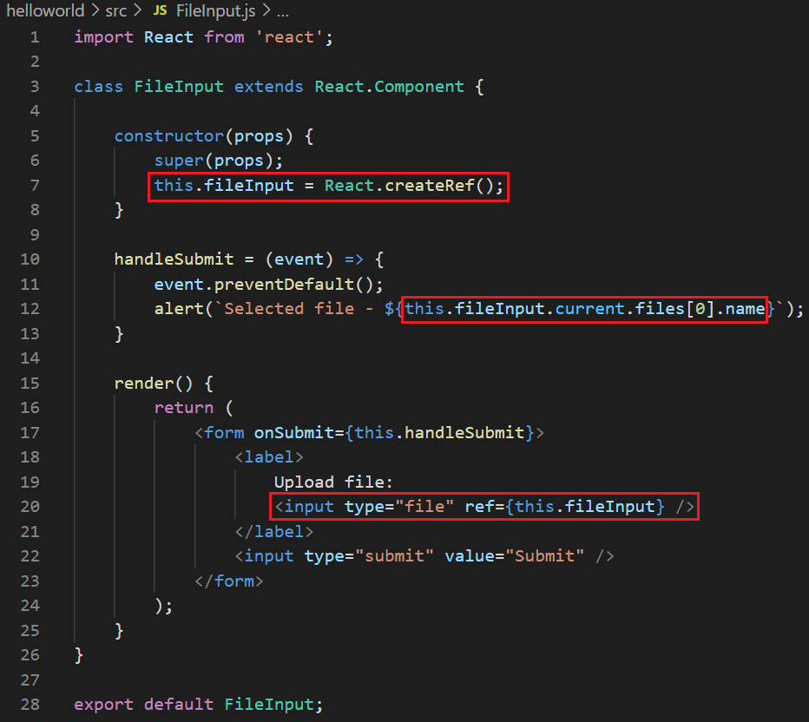
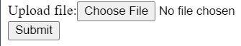
Uncontrolled Component
File
File is always uncontrolled component (because value can only be set by User, not programmatically)
Example 3:
https://reactjs.org/docs/uncontrolled-components.html#the-file-input-tag

Slide 22
Testing System Assignment
Self-practice

Slide 23
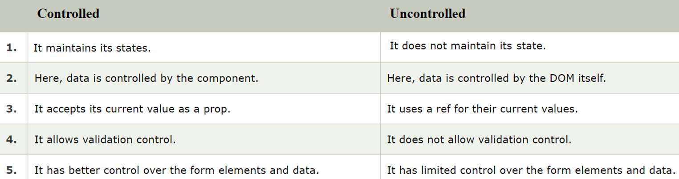
Comparing Controlled & Uncontrolled Component

Slide 24
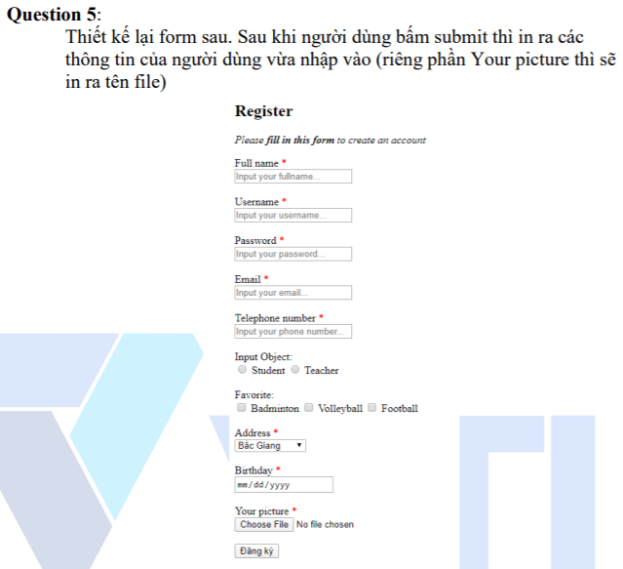
Testing System Assignment
Exercise 2: Form – Question 5

Slide 25
Libraries
https://formik.org/
Based on controlled components and managing state

Slide 26
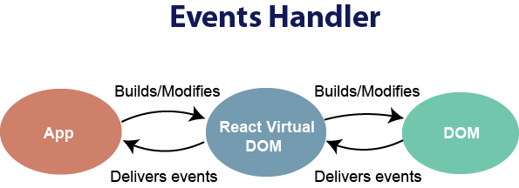
Event
Similar to interface for browser’s event

Slide 27
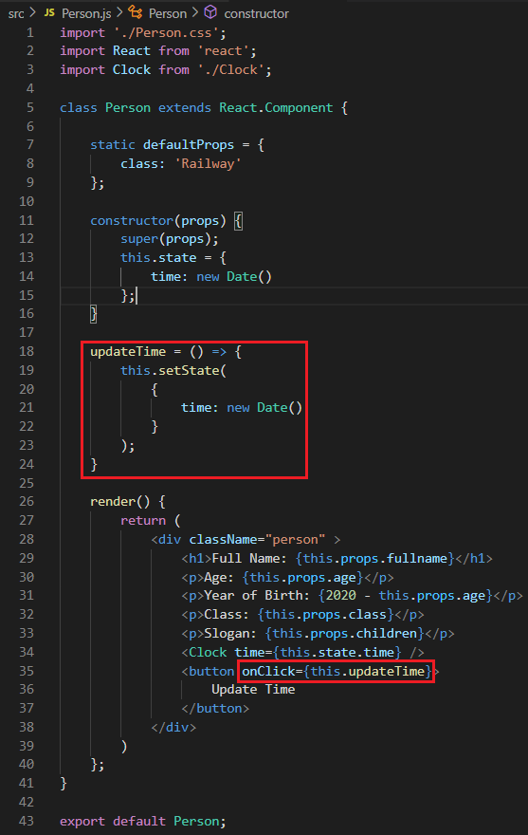
Event
Example 1:

Slide 28
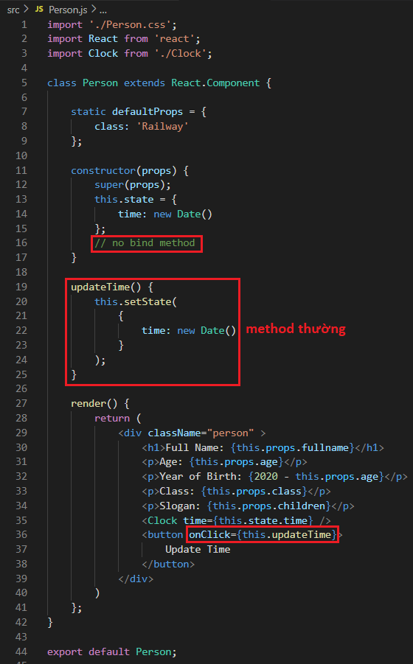
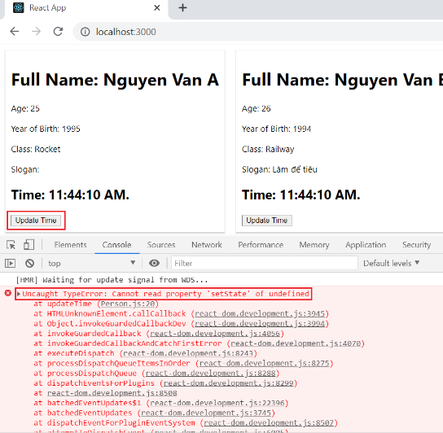
Event
Syntax
Problem 1: this keyword
Cannot using keyword this in method
"This" Scope: local

Slide 29
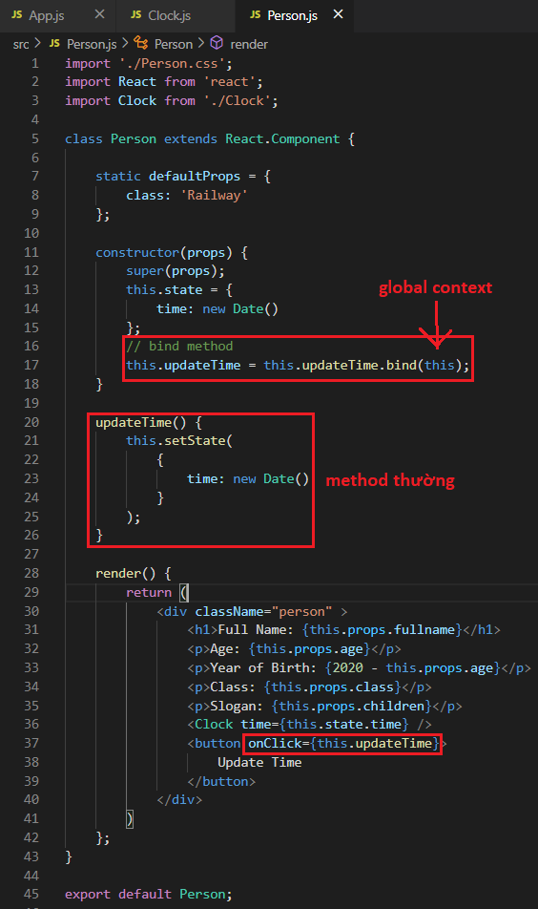
Event
Syntax
Solution 1: bind method (not recommended)
"This" Scope: global

Slide 30
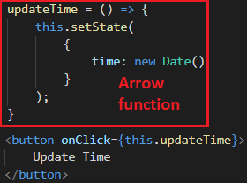
Event
Syntax
Solution 2: Arrow function (recommended)
"This" Scope: global

Slide 31
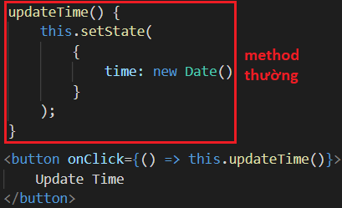
Event
Syntax
Solution 3: ES6
"This" Scope: global

Slide 32
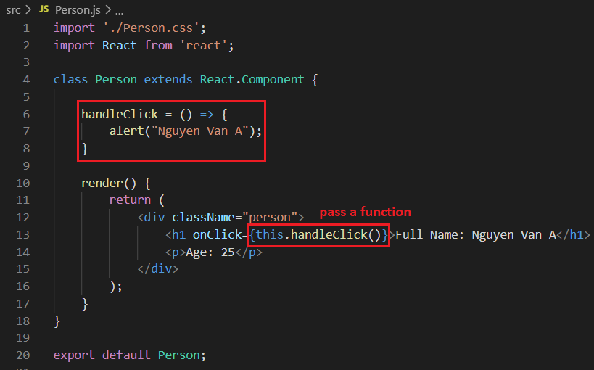
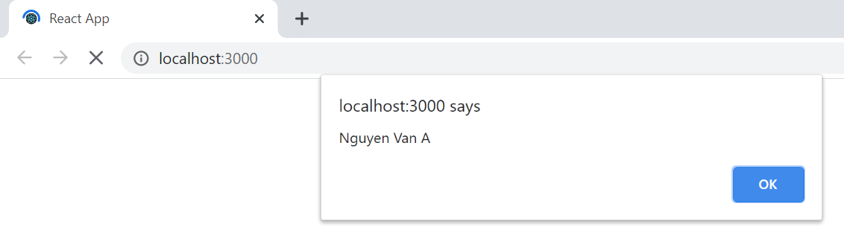
Event
Syntax
Example 2: Problem 2 pass method when rendering
When rendering the component will automatically call the method (wrong)

Slide 33
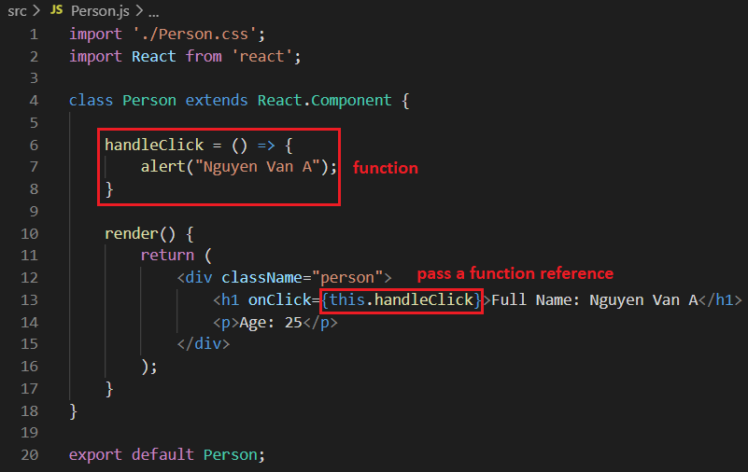
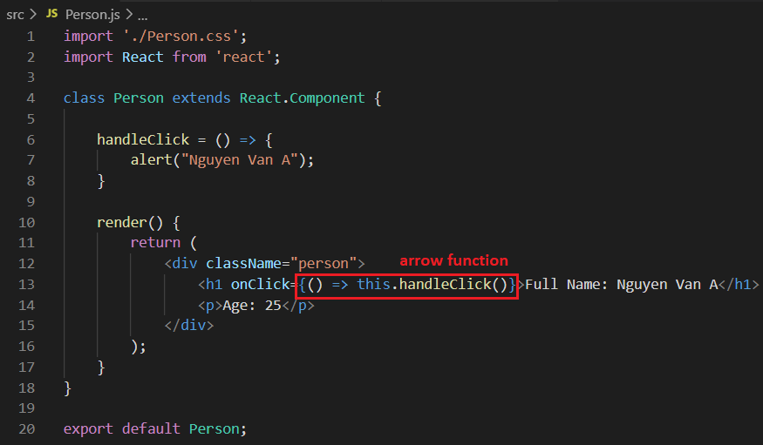
Event
Syntax
Solution
Solution 1: pass a function reference
Solution 2: ES6
When you click then ReactJS will call handleClick() function.

Slide 34
Testing System Assignment
Self-practice

Slide 35
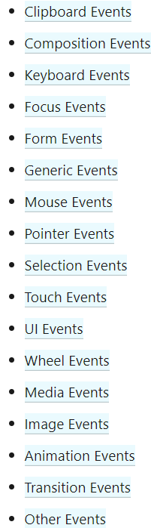
Event
Supported Event
https://reactjs.org/docs/events.html#supported-events

Slide 36
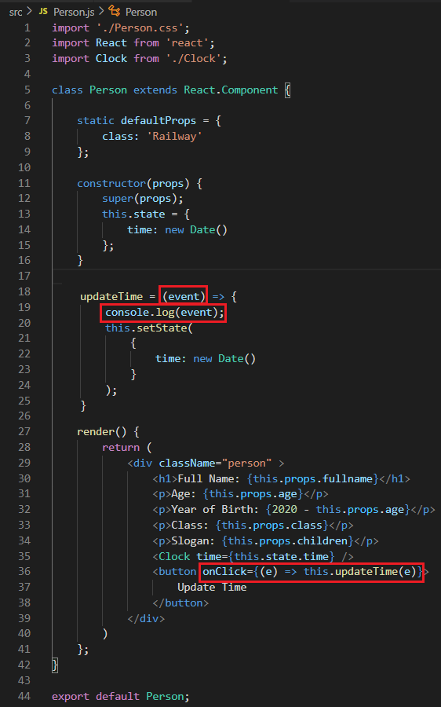
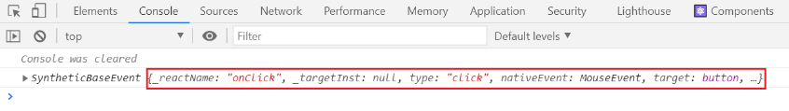
Event
Example 3: Get information event

Slide 37
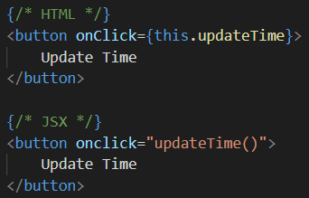
Event
Note
Using camelcase

Slide 38
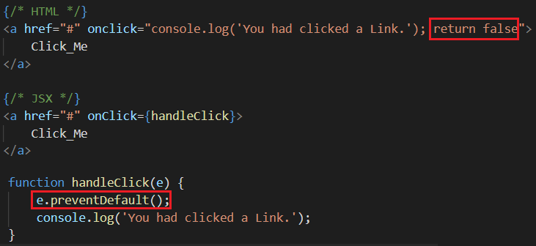
Event
Note
DO NOT implement default behavior

Slide 39
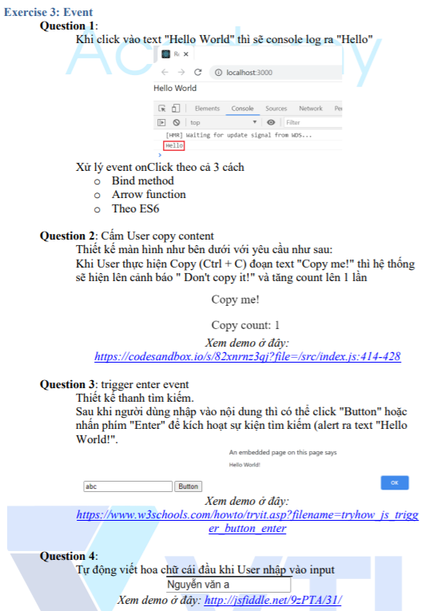
Testing System Assignment
Exercise 3: Event

Slide 40
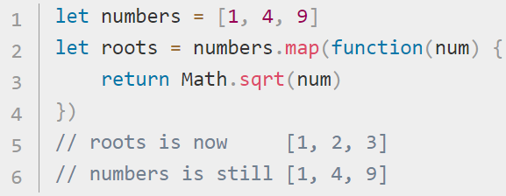
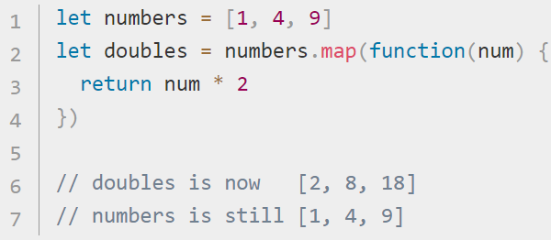
map() method
Similar to foreach

Slide 41
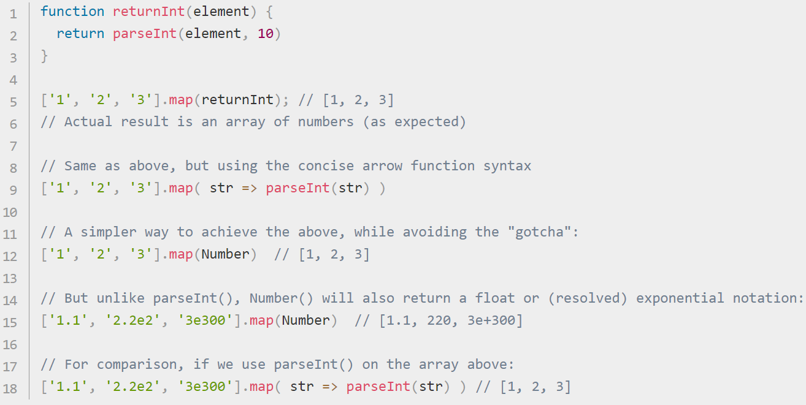
map() method
https://developer.mozilla.org/en-US/docs/Web/JavaScript/Reference/Global_Objects/Array/map

Slide 42
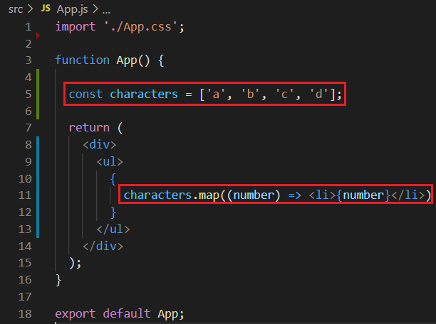
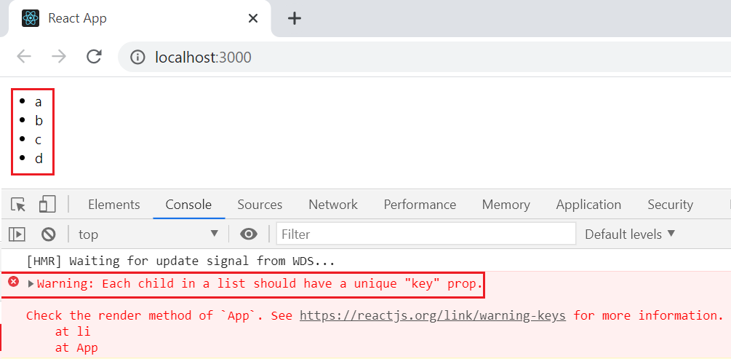
List
Using map() method
Example 1: render list characters

Slide 43
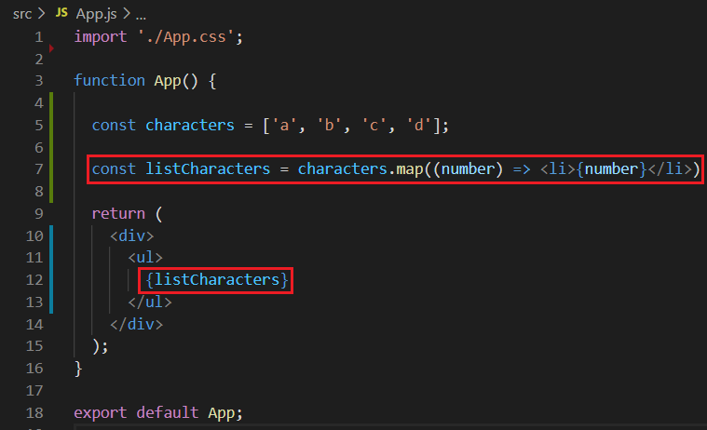
List
Example 2:
https://codepen.io/gaearon/pen/GjPyQr?editors=0011

Slide 44
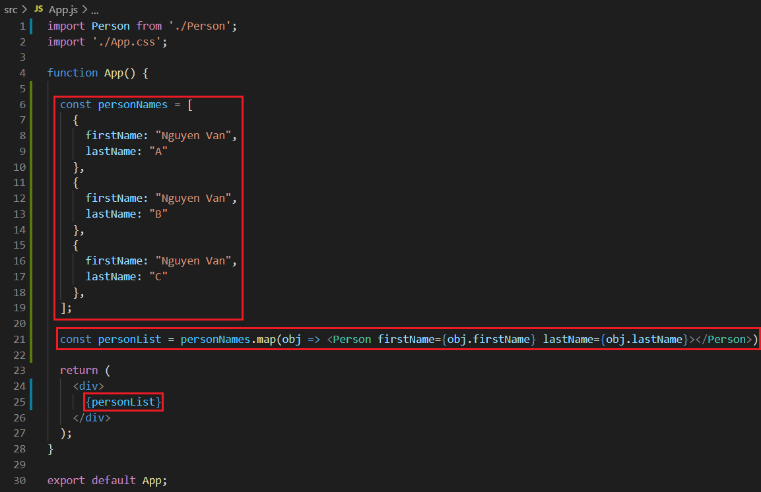
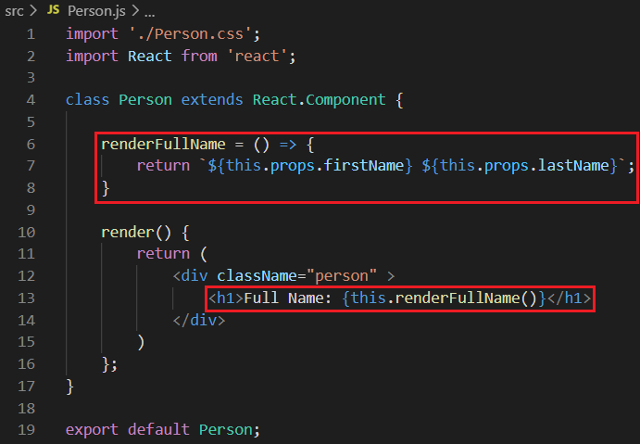
List
Example 3: render list Persons

Slide 45
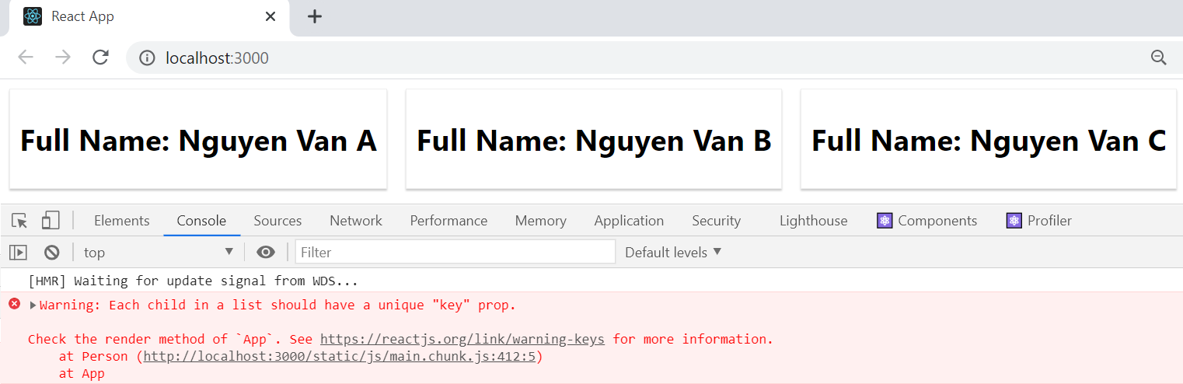
List

Slide 46
Testing System Assignment
Self-practice

Slide 47
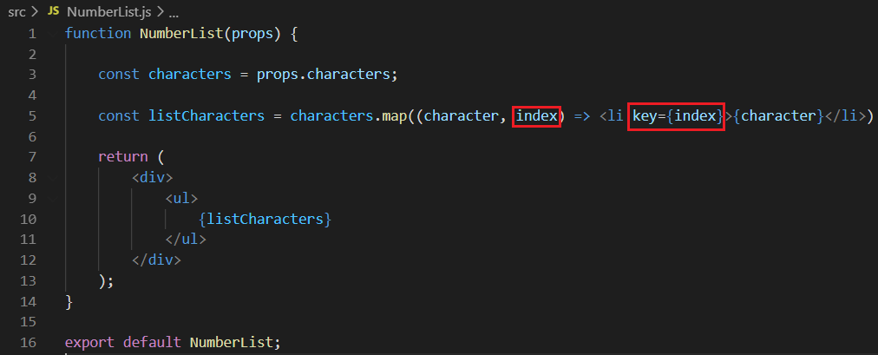
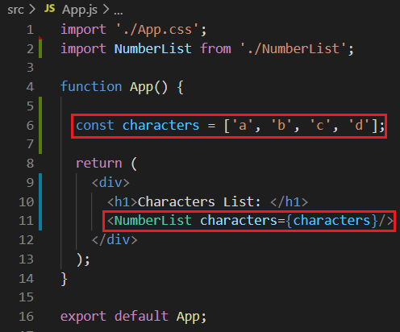
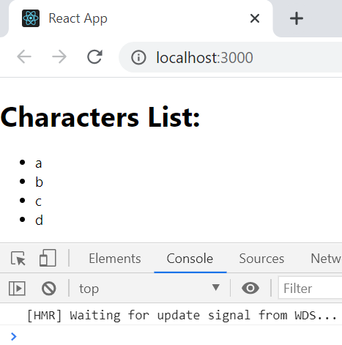
Key
Key helps determine which items to re-render 🡺 will update the UI more efficiently
Should be unique
Example 4:
No more warnings
Not recommend using the index

Slide 48
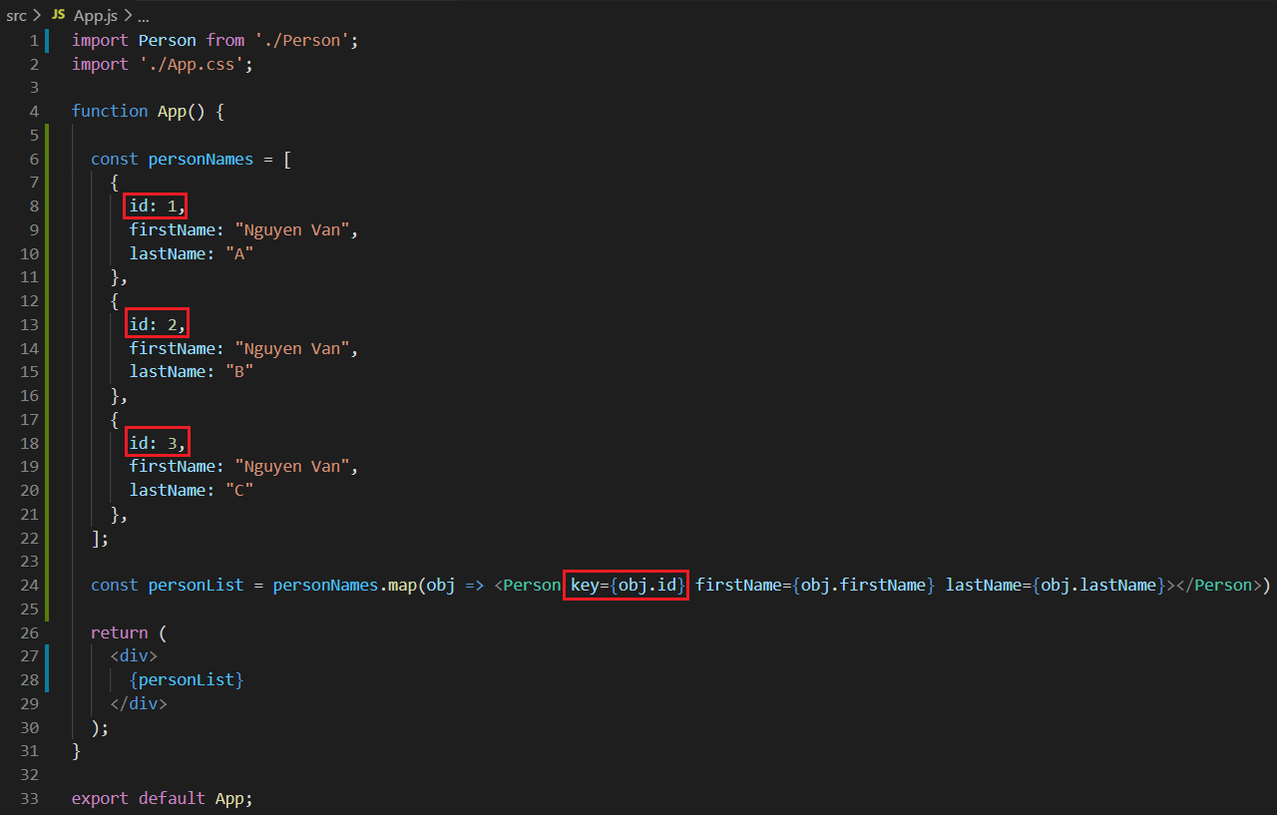
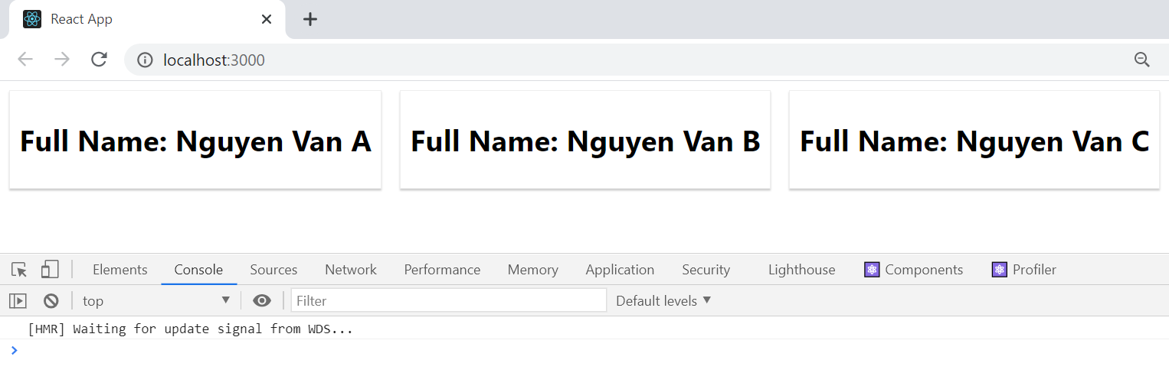
Key
Example 5: using id

Slide 49


List & State
Example 6:

Slide 50



List & State
Clicking on any person will delete that person
Source code

Slide 51
Testing System Assignment
Self-practice

Slide 52

List & State
Example 7:

Slide 53


List & State
Input into <input> tag, it will automatically bind to the Full Name

Slide 54
Testing System Assignment
Self-practice

Slide 55
Render component
Render Component into DOM
Everything is in the "root" DOM (App component) managed by React
https://reactjs.org/docs/rendering-elements.html

Slide 56

Render component
Update Component
Component is immutable (meaning that the props and attributes cannot be updated), so it can only be re-rendered
Way 1: Using ReactDOM.render() to re-render
https://reactjs.org/docs/rendering-elements.html#updating-the-rendered-element

Slide 57
Render component
Update Component
Only update the necessary things ➔ need to split the component
Way 2: Using setState() to re-render

Slide 58


Render component
Conditional render
Instead of display:none in Javascript
If the condition is complicated, it should separate a smaller component
Way 1: using if
https://codepen.io/gaearon/pen/ZpVxNq?editors=0011
https://codepen.io/gaearon/pen/QKzAgB?editors=0010

Slide 59


Render component
Conditional render
Way 2: ternary

Slide 60

Render component
Conditional render
Way 3: Switch case

Slide 61

Render component
Conditional render
Way 4: using Logical && operator
https://codepen.io/gaearon/pen/ozJddz?editors=0010

Slide 62

Render component
Conditional render
Hide component ➔ return null
https://codepen.io/gaearon/pen/Xjoqwm?editors=0010

Slide 63

Testing System Assignment
Exercise 5: Render Element

Slide 64

Testing System Assignments

Slide 65

React DevTools

Slide 66
Reference
https://reactjs.org/docs/getting-started.html
https://www.javatpoint.com/reactjs-tutorial
https://www.udemy.com/course/react-the-complete-guide-incl-redux

Slide 67
Q & A
Copyright © VTI Academy All Rights Reserved

